Slide 1
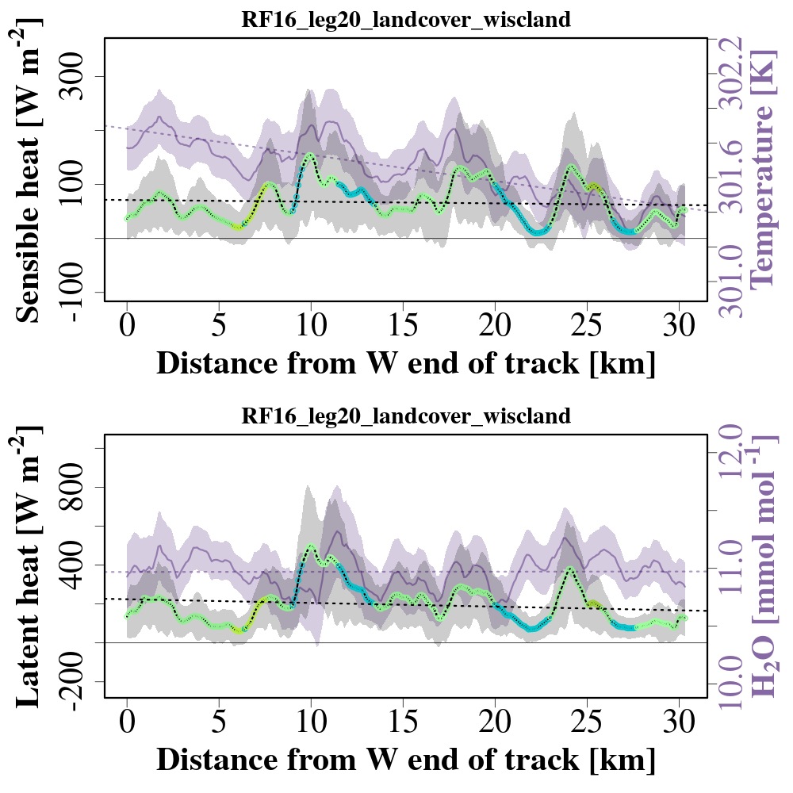
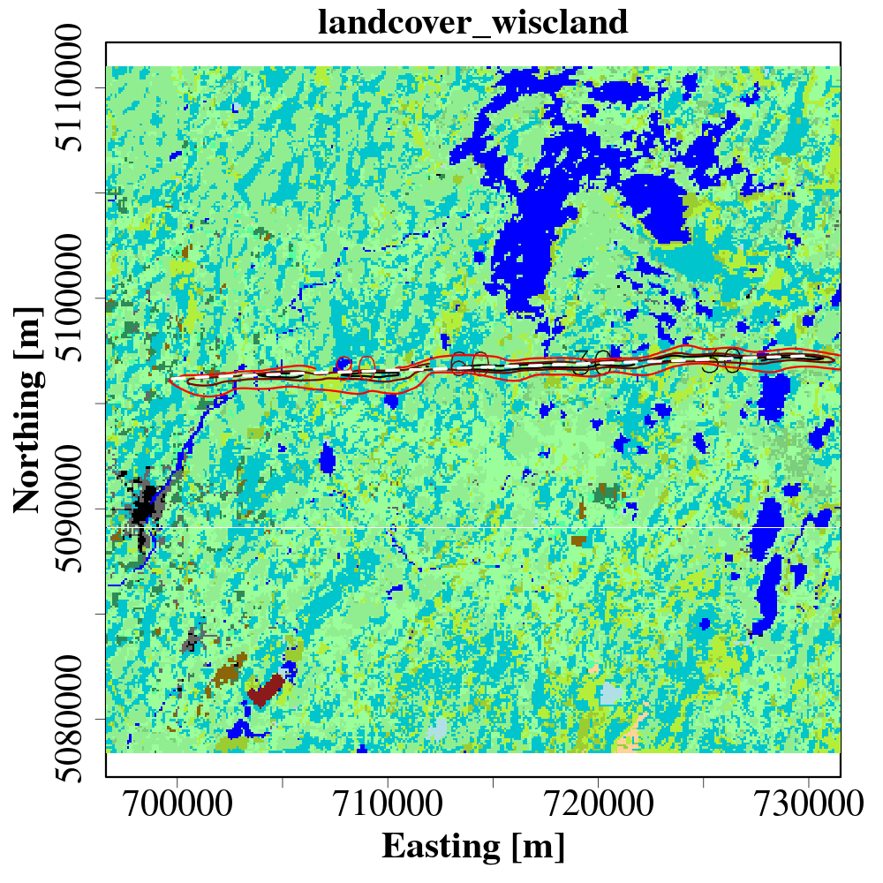
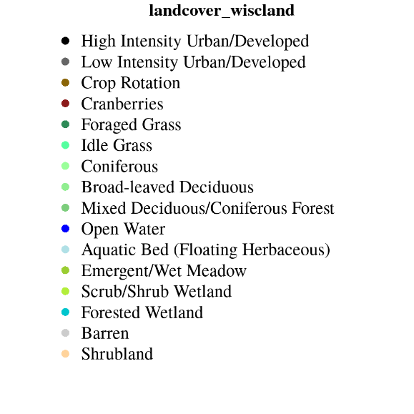
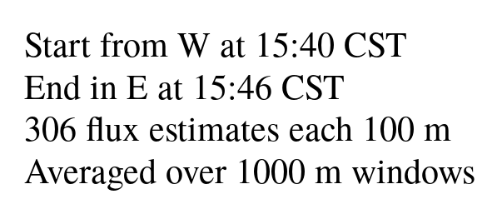
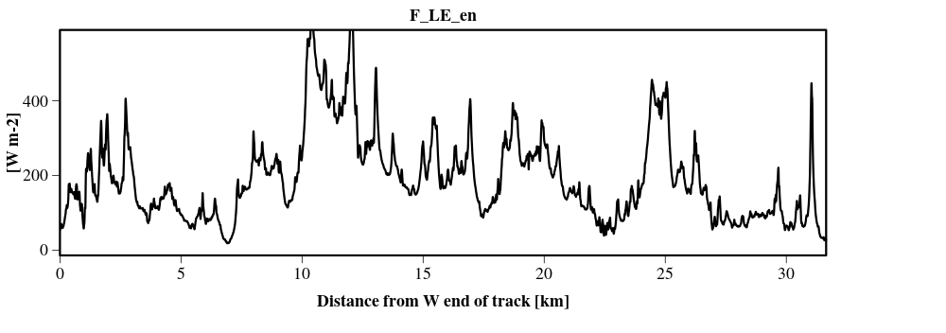
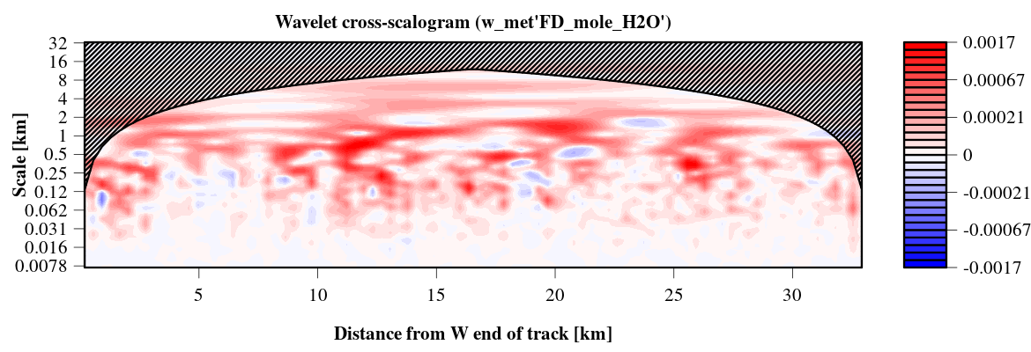
Spatially resolved fluxes:
Notes:
Some preliminary results: Mention we have this data for all 40 flight legs. Eddy4r helps process data at scale
Afternoon flight, leg over waterbodies, patchy surface, wind blowing from w-wsw
Flux footprint model : Kljun, footprint over some wetlands and tiny lakes
Largescale structures, < 2km in the cross scaleogram plots

Slide 2
Notes:
Some preliminary results: Mention we have this data for all 40 flight legs. Eddy4r helps process data at scale
Afternoon flight, leg over waterbodies, patchy surface, wind blowing from w-wsw
Flux footprint model : Kljun, footprint over some wetlands and tiny lakes
Largescale structures, < 2km in the cross scaleogram plots

